Slide 1
Course Selection Process
Newsome High School

Slide 2
What do I need to know about high school?
4 English
4 Math (Algebra +Geometry)
3 Social Studies (US Gov, US Hist, World Hist, Econ)
3 Science (Bio+2 lab)
2 Foreign Language (college admissions)
1 HOPE (specific Physical Education)
1 Art (Practical or Fine/Performing)
1 Reading (Newsome requirement)
1 Online Course (completed class; not 1 credit)

Slide 3
Enrichment/Advancement
Dual Enrollment (classes at HCC)
3.0 High School GPA (maintain a 2.0 at the college)
Test scores (SAT/ACT/PERT) impact what classes a student can take
Transferrable within Florida, up to 60 hours
Student starts a college transcript
Advanced Placement
No specific requirements; 3.0 GPA and grade level reading
College credit opportunity by exam
Nationally transferrable
Grade performance affects high school only

Slide 4
General Guidance
Three GPA (Grade Point Averages exist)
State: 4.0 Max scale, only looks at letter grade
District: no Max scale, bonus of .04/semester for Honors; .08/semester for AP/Dual Enrollment
State University System: bonus of .5/year for Honors; 1.0/year for AP/Dual Enrollment; only looks at core classes (electives do not impact this GPA)
Bright Futures
Subject to change: 3.0 SUS GPA or 3.5 SUS GPA
Test scores
Community service

Slide 5
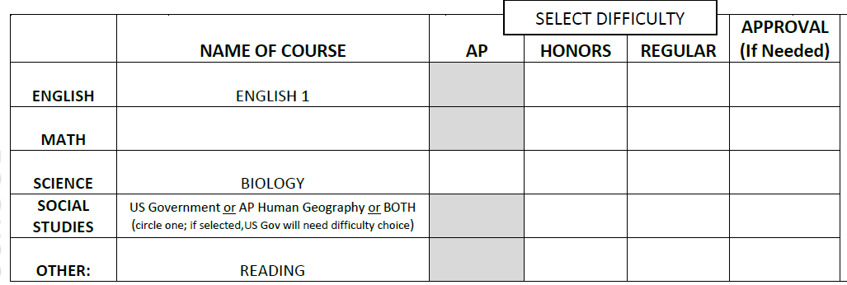
Core classes are largely locked in,
We only need to know the difficulty.
Math will follow the sequence of Algebra,
Then Geometry, then Algebra 2
Check or “X” the box of what level you want
Freshman normally have US Gov by itself or AP Human; both can be taken to complete freshman social studies requirement
Choosing both is perfectly fine; students/parents need to recognize this will consume an elective slot to fill both

Slide 6
Social Studies and Electives
Did you choose US Government? You will need a semester elective to go with it, to complete your schedule
Did you choose both? You will have 1 less elective, as AP Human will count as an elective
Did you choose AP Human only? You will have to take US Government in a future year or online
Do you want more elective slots? You will need to take a class online to free up space to accommodate this (either now or over the summer)

Slide 7
Electives
Students list electives in order of preference. The back
Does not need any numbers or checks. We will honor what is listed
In this designated space.
Only necessary if grade concerns: AP Human
Could be listed here with permission
Please list electives in rank order. We will make every effort to place students into their top choices. Most freshman
will only have space for 1 or 2 electives. More space can be created by taking things online. Anything taken online
Could be listed here with a comment. (For example: “HOPE on FLVS”)

Slide 8
Early Release/Part Time Schedules
Students can be “co-enrolled” and take part of their day online. Students will need to arrange this with their counselor at the start of school. This form and process does not accommodate these situations. We would review student performance to ensure they are successful with online courses, before we take the steps of removing them from things they may need for graduation.
Please complete this form as though you are attending a full day
Part time situations will be reviewed case-by-case
Students can be excused 1 period early for each class taken off campus (for virtual school or for Dual Enrollment)
Students cannot split time between two schools, as per Board policy

Slide 9
Final Thoughts
University Admissions
Ivy League/Elite out of state: Dual Enrollment may not be accepted; careful consideration for class selection and students will need to take the most rigorous schedule (demonstrate a natural love of learning and back it up with an elite GPA)
University of Florida/Florida State: very rigorous to get in and will require a large number of AP/Dual Enrollment courses, along with high test scores and grades

Slide 10
Final Thoughts
HCC Dual Enrollment website
https://www.hccfl.edu/dualenrollment
AP Course Credit Policy
https://apstudent.collegeboard.org/creditandplacement/search-credit-policies
Florida Virtual School
https://flvs.net/flex/courses

