Slide 1
Newsome High School
8th Grade Transition
Joseph Sandfrey, School Counselor

Slide 2
Basics of High School
Credits
GPA
College Preparation/Rigor
Tests (lots of tests)
Scheduling (Programming)
Other opportunities
Dual Enrollment
Virtual School
On-The-Job Training

Slide 3
Credits
24 credits for a Standard Diploma (basics)
4 English (1, 2, 3, 4)
4 Math (Algebra 1, Geometry, +2 others)
3 Science (Biology+ 2 others of Equally Rigorous difficulty)
3 Social Science (.5 US Government, 1.0 World History, 1.0 US History, .5 Economics)
1 Art
1 Online course (either .5 or 1.0 credits)
1 HOPE (Health Opportunities Through Physical Education)
Waiver exists for playing 2 seasons of a sport
2 Years of ROTC counts as both an Art/HOPE credit, via a waiver

Slide 4
Credits (College Bound)
24 credits for a Standard Diploma (College Recommendations)
4 English (1, 2, 3, 4)
4 Math (Algebra 1, Geometry, +2 others) Alg 2, Trig, or higher
3 Science (Biology+ Chemistry + 2 other) 4th Science
3 Social Science (.5 US Government, 1.0 World History, 1.0 US History, .5 Economics)
1 Art
1 Online course (either .5 or 1.0 credits)
1 HOPE (Health Opportunities Through Physical Education)
Waiver exists for playing 2 seasons of a sport
2 Years of the same Foreign Language

Slide 5
Grade Point Average
Three GPAs exist
1) State: only looks at letter Grade (A=4, B=3, C=2, etc)
Maximum GPA of 4.0
2.0 GPA to graduate; 2.0 GPA to play sports
2) District: adds bonus points to the State GPA
.04 per semester of Honors
.08 per semester of Advanced Placement/Dual Enrollment
Does not have a maximum number (scale)
Affects class rank
State University System (SUS): Core classes (Eng, Math, Sci, SS, FL)
.5 per year of Honors
1.0 per year of AP/Dual Enrollment

Slide 6
College Preparation: Simulation
What is better?
World History: A [4.0 State, 4.0 District, 4.0 SUS]
World History Honors: B [3.0 State, 3.08 District, 3.5 SUS]
AP World History: C [2.0 State, 2.16 District, 3.0 SUS]
What is better if the grades are all equal?
World History: A [4.0 State, 4.0 District, 4.0 SUS]
World History Honors: A [4.0 State, 4.08 District, 4.5 SUS]
AP World History: A [4.0 State, 4.16 District, 5.0 SUS]
SHOULD A STUDENT TAKE HARDER CLASSES? IT REALLY DEPENDS ON EACH STUDENT, THEIR GOALS, AND POTENTIAL UNIVERISTY…

Slide 7
SUS Matrix LINK

Slide 8
College Preparation
I want to drop [COURSE NAME] because I don’t want it to lower my GPA!
Before:
After (with an F):

Slide 9
What do colleges want?
PTSA/Newsome Collaboration
Regular communication
Senior Schedule advisement: LINK
RIGOR=Shows you challenge yourself
GRADES/GPA=Raw performance
CLASS RANK=Comparison to peers
TEST SCORES=Standard measurements
SCHOOL COMMUNITY=Intangibles, character, athletics, life balance, etc.
OTHER: ??? (Interview, essays, recommendations, etc)

Slide 10
Florida State Example

Slide 11
Course Selections (Summation)
College Preparation
Take the most rigorous courses possible, to actively challenge and engage you as a student
AP and Honors is not right for everyone; assess your personal qualities, motivation, test scores, and other data to choose wisely
Don’t let a low grade get you down; work to raise it
Pick classes based on your goals; not social pressure/friends, or to be something you are not
GPA matters but is not the only level of evaluation; difficulty and class rank matter too
Impact on “School Community”
Influence of Virtual School

Slide 12
Virtual Options/Dual Enrollment
ALL students wishing to earn a Newsome Diploma/enrolled “Full-Time” must have 7 courses
These 7 courses could be a combination of Virtual or Dual Enrollment
Minimum of 2 courses on Newsome’s campus
Co-Enrollment
“Part-time” Virtual with “Part-time” Newsome
Must comply with 7 class rule
For scheduling purposes, pretend the student will be on campus for a full day; work with individual counselors when school starts
Permission form: Non-Traditional Agreement LINK
Need for us to plan seat space for students, if situations change
Florida Virtual/Hillsborough Virtual School course list: LINK

Slide 13
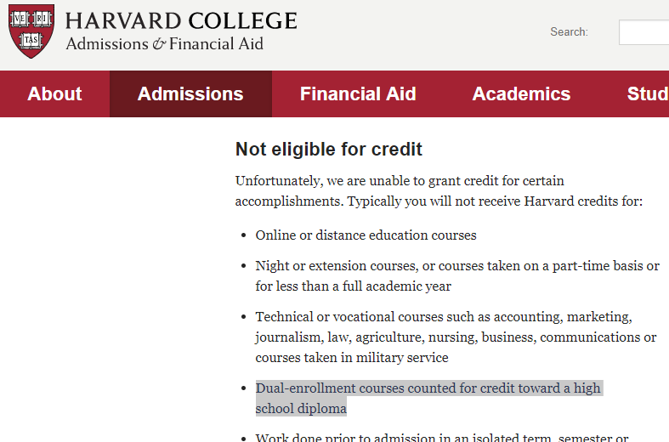
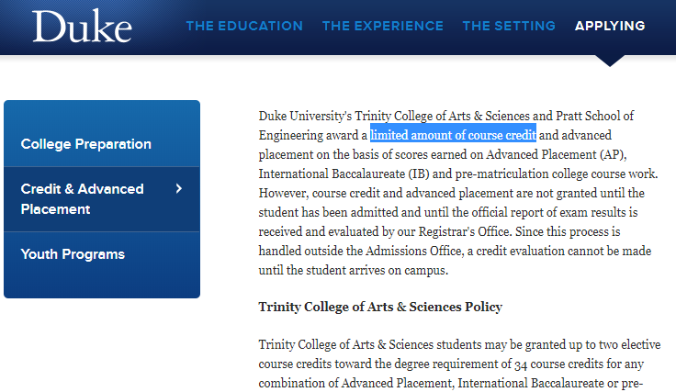
Dual Enrollment https://www.hccfl.edu/dualenrollment
Taking College Courses while in High School
Credits count in both places
Start of a College Transcript: MATURITY REQUIRED
Not excepted in all places or transfer limits imposed (some examples below)
Harvard: does not accept Dual Enrollment
Dartmouth: 17 credit limit
MIT: does not accept Dual Enrollment math courses
**Consult the university admissions site to see each school’s policy**
Opportunity to transfer individual classes or earn an Associate’s Degree
60 credit hour transfer limit (about 20 total classes)
Could be a combination of AP and Dual Enrollment credits
Curriculum is largely based on professors
Parents have very limited rights to contact professors, check on grades, etc.

Slide 14
Advanced Placement Source:https://secure-media.collegeboard.org/digitalServices/pdf/research/2017/2017-Score-Distribution-All-Subjects.pdf
Managed by College Board (same company as SAT exams)
College Credit opportunities BY EXAM
58% of students earn a 3 or higher (credit opportunity)
Some schools vary by score LINK
Higher scores (4/5) often yield additional credits (such as earning two classes)
Great option for students that are strong test takers
Will prepare students for college regardless of what they score; is the goal to prepare students for rigorous college courses or to earn college credit?
NOT necessarily the start of a start of a college transcript
Students that demonstrate weakness provide the high school an opportunity to change a schedule. A student sitting in a Dual Enrollment course cannot easily drop, switch, or adjust a schedule
Nationally recognized curriculum and standardized tests

Slide 15
OJT (On-the-Job Training)
Work Release Program
Open to Juniors/Seniors
Must be employed
Must be co-enrolled into a Agriculture or Business class
NOT intended for college bound students
Drop-out prevention
Low GPA/credit opportunity
Employability skills
Unique situations where a student needs to work
Work with students to help find a job, after a job loss

Slide 16
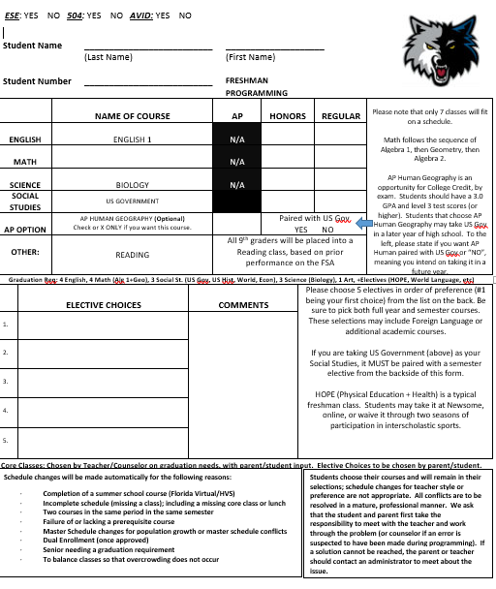
Schedule Form: At A Glance
COURSE DESCRIPTIONS
http://newsome.mysdhc.org/Programs/Navigator%202017-2018.pdf

Slide 17
Completing the Form
English 1
Choose the difficulty level

Slide 18
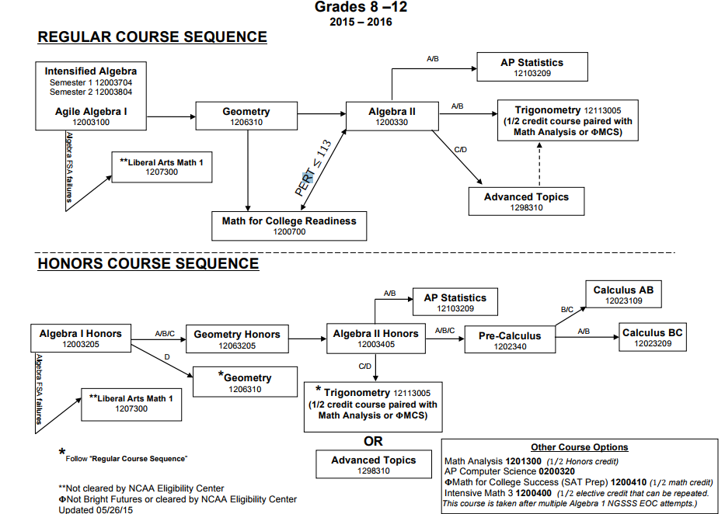
Completing the Form
Math Sequence
Choose difficulty (regular or Honors)
Flow Chart LINK

Slide 19
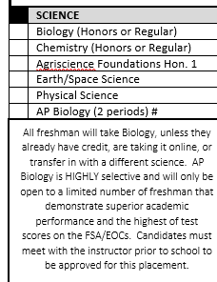
Completing the Form
Science
Biology for all freshman
Possible exceptions
Concern for success on Biology EOC
Agriculture programs encompass a 4 year commitment
AP Biology
Highly selective
Teacher approval only
No freshman students will be placed into AP Biology
Teacher will inform us of any candidates that are admitted in

Slide 20
Completing the Form
Social Studies
Three Options
1) Normal Freshman Social Studies: US Government
Choose difficulty: Honors or Regular
2) AP Human Geography
First AP Opportunity
Elective only (not required for Graduation)
3) BOTH AP Human and US Government
Consumes two periods (7 period school day)

Slide 21
Completing the Form
Reading
Approximiately 70% of students at Newsome take an AP Course
Exposure to critical reading/writing
School accountability models: “Raising a level”
Those students that demonstrate a weakness in Reading (not “at grade level” will receive remediation, prior to their next test)
All Freshman will sit for Reading unless parents opt-out of the Reading course
FORM LINK

Slide 22
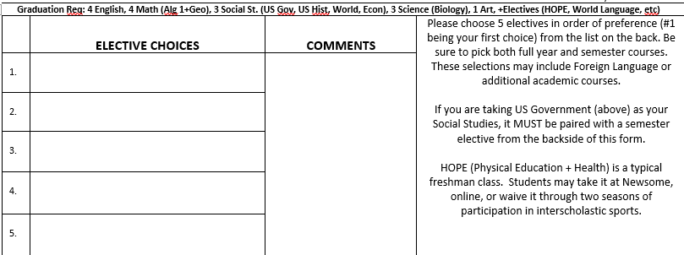
Completing the Form
Electives
Spaces provided are for 5 selections
Not all choices will appear on a student’s schedule
Remember: 8 period school day with 1 period of lunch (7 classes)
Semester electives (half year) need to be paired with another semester course
If US Government is selected, at least one semester course will need to be paired with it
Please list more than just one semester course; some classes conflict or are full

Slide 23
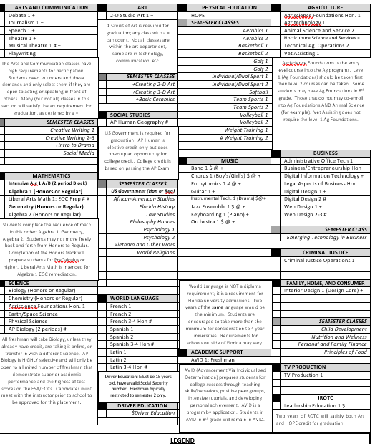
Completing the Form
Back view (List of courses)
Core courses are not listed, as the counselor will place items that are required for graduation
Some exceptions for math/science and social studies pathway
Comments on the back to help guide selections
Selections will increase for grades 10-12

Slide 24
Completing the Form
Final steps
1) Read the schedule change procedure
2) Don’t forget to put your name
3) Sign the form to validate your selections
4) Turn forms into your Middle School Counselor
If you are doing any Virtual classes in the summer between Middle School and High School, the Middle School counselor must approve
Classes can be selected/approved 6 months ahead of time
Students/parents need to change their “Academic Profile” to Newsome, so we can see the final grades
Any course that starts with M/J is a Middle School Course=no high school credit
If you wish to make any revisions, simply print a new form and write “REVISED” on the form. Turn into Middle School/High School counselor.

Slide 25
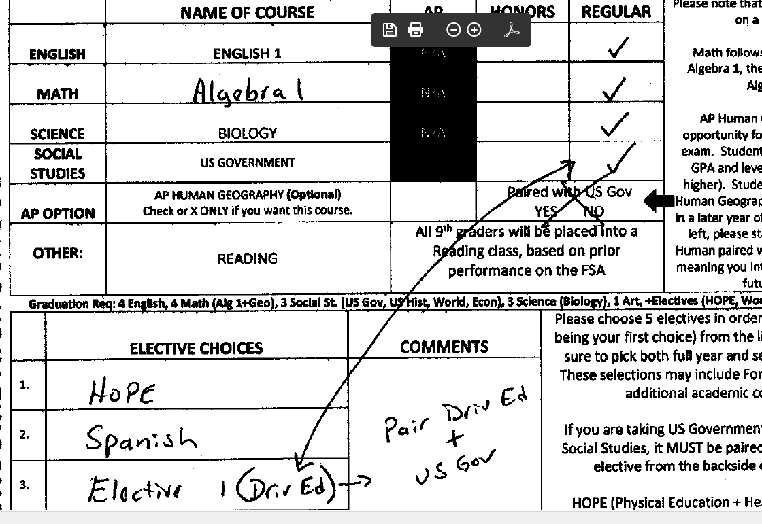
Completed Sample Forms

Slide 26
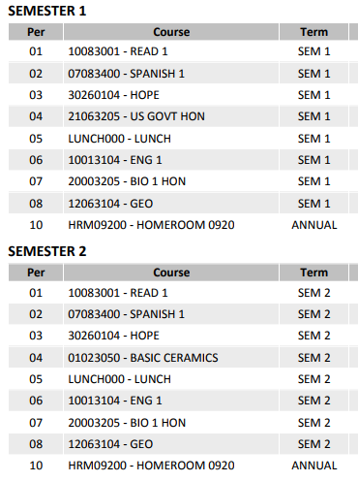
Sample Non-Honors Schedule

Slide 27
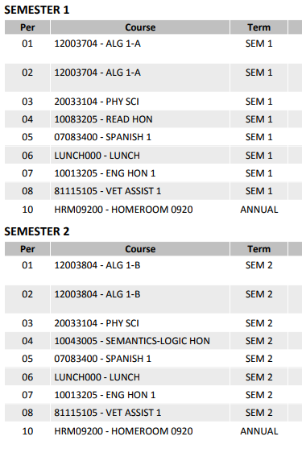
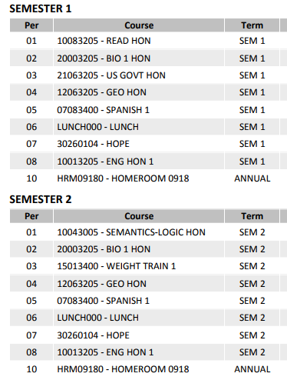
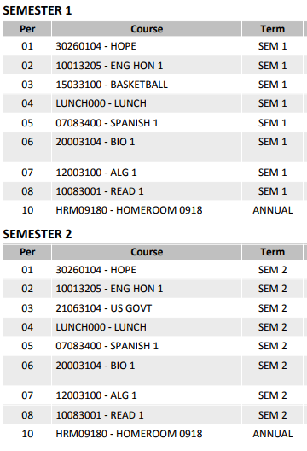
Sample Mid-Range Schedule

Slide 28
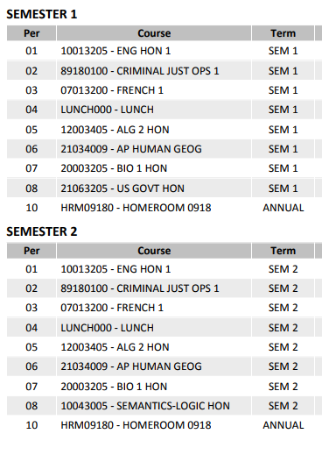
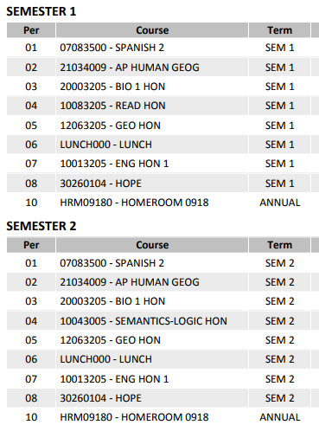
Sample High-Honors Schedule

Slide 29
Final Thoughts
Are you currently receiving extended time?
504s and IEPs will continue at the high school level
State mandated assessments will qualify
Outside tests (ACT, AP, SAT) must be requested and approved
This is not an automated process
Parents must complete a consent form→submitted to SSD Coordinator for submission
Information: https://www.collegeboard.org/students-with-disabilities/documentation-guidelines
https://www.collegeboard.org/students-with-disabilities/forms
First test is the Practice SAT (PSAT), traditionally in October

Slide 30
Who Does What?
Administration
Registrar
Counselors
-supervision of teachers
-attendance/Discipline
-budgets and school management
-records requests
-receiving of records
-entry of grades (FLVS/Dual Enrollment)
-processing of new student records (point of contact)
-processing of new student enrollment paperwork
-academic advisement
-emotional-social counseling
-career guidance
-processing of Dual Enrollment paperwork
-student placement (classes)
-record interpretation

Slide 31
Final Thoughts
Know the challenges to young people
CDC Report: https://www.cdc.gov/std/stats16/CDC_2016_STDS_Report-for508WebSep21_2017_1644.pdf
Teen Suicide (Child and Family Services): http://www.dcf.state.fl.us/programs/samh/docs/Florida%20Suicide%20Prevention%20Plan%202016-2020.pdf
Substance Use (Child and Family Services): http://www.dcf.state.fl.us/programs/samh/publications/fysas/2016Survey/2016%20FYSAS%20Statewide%20Report.pdf

